Slide 1
My Perimeter, Area and Volume Interactive Notebook
Name
Class
Term 3 Semester 2

Slide 2
Contents
Formula Page
Page
Date
Description
2
3

Slide 3
Tasks
24
7
30
Essential Question
Questions
Notes
Summary
6
7

Slide 4
24
7
30
Date
Circumference
EQ – Describe the relationship between the radius, diameter and circumference?
7

Slide 5
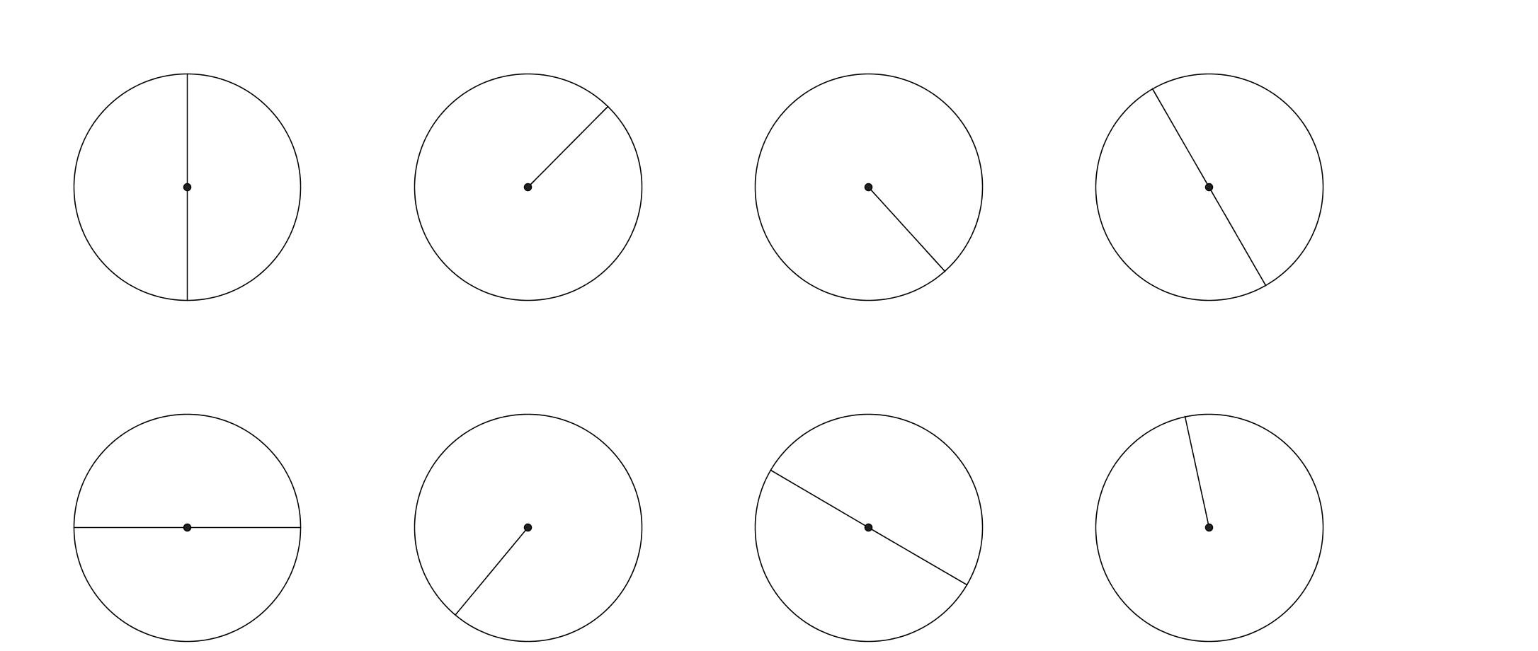
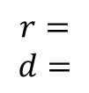
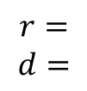
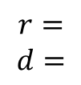
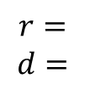
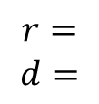
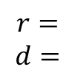
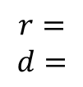
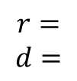
Task One- Write down the radius and diameter of each circle.
7m
10m
25cm
26mm
$$r=$$
$$d=$$
$$r=$$
$$d=$$
$$r=$$
$$d=$$
$$r=$$
$$d=$$
6.9cm
13.2mm
2.4m
0.8cm
$$r=$$
$$d=$$
$$r=$$
$$d=$$
$$r=$$
$$d=$$
$$r=$$
$$d=$$

Slide 6
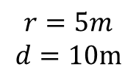
Task One- Write down the radius and diameter of each circle.
7m
10m
26mm
25cm
$$r=5m$$
$$d=10m$$
$$r=$$
$$d=$$
$$r=$$
$$d=$$
$$r=$$
$$d=$$
6.9cm
13.2mm
2.4m
0.8cm
$$r=$$
$$d=$$
$$r=$$
$$d=$$
$$r=$$
$$d=$$
$$r=$$
$$d=$$

Slide 7
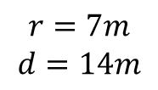
Task One- Write down the radius and diameter of each circle.
7m
10m
26mm
25cm
$$r=5m$$
$$d=10m$$
$$r=7m$$
$$d=14m$$
$$r=$$
$$d=$$
$$r=$$
$$d=$$
6.9cm
13.2mm
2.4m
0.8cm
$$r=$$
$$d=$$
$$r=$$
$$d=$$
$$r=$$
$$d=$$
$$r=$$
$$d=$$

Slide 8
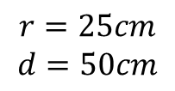
Task One- Write down the radius and diameter of each circle.
7m
10m
26mm
25cm
$$r=5m$$
$$d=10m$$
$$r=7m$$
$$d=14m$$
$$r=25cm$$
$$d=50cm$$
$$r=$$
$$d=$$
6.9cm
13.2mm
2.4m
0.8cm
$$r=$$
$$d=$$
$$r=$$
$$d=$$
$$r=$$
$$d=$$
$$r=$$
$$d=$$

Slide 9
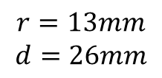
Task One- Write down the radius and diameter of each circle.
7m
10m
26mm
25cm
$$r=5m$$
$$d=10m$$
$$r=7m$$
$$d=14m$$
$$r=25cm$$
$$d=50cm$$
$$r=13mm$$
$$d=26mm$$
6.9cm
13.2mm
2.4m
0.8cm
$$r=$$
$$d=$$
$$r=$$
$$d=$$
$$r=$$
$$d=$$
$$r=$$
$$d=$$

Slide 10
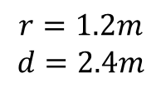
Task One- Write down the radius and diameter of each circle.
7m
10m
26mm
25cm
$$r=5m$$
$$d=10m$$
$$r=7m$$
$$d=14m$$
$$r=25cm$$
$$d=50cm$$
$$r=13mm$$
$$d=26mm$$
6.9cm
13.2mm
2.4m
0.8cm
$$r=1.2m$$
$$d=2.4m$$
$$r=$$
$$d=$$
$$r=$$
$$d=$$
$$r=$$
$$d=$$

Slide 11
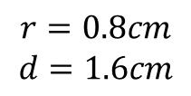
Task One- Write down the radius and diameter of each circle.
7m
10m
26mm
25cm
$$r=5m$$
$$d=10m$$
$$r=7m$$
$$d=14m$$
$$r=25cm$$
$$d=50cm$$
$$r=13mm$$
$$d=26mm$$
6.9cm
13.2mm
2.4m
0.8cm
$$r=1.2m$$
$$d=2.4m$$
$$r=0.8cm$$
$$d=1.6cm$$
$$r=$$
$$d=$$
$$r=$$
$$d=$$

Slide 12
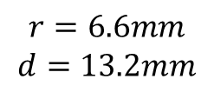
Task One- Write down the radius and diameter of each circle.
7m
10m
26mm
25cm
$$r=5m$$
$$d=10m$$
$$r=7m$$
$$d=14m$$
$$r=25cm$$
$$d=50cm$$
$$r=13mm$$
$$d=26mm$$
6.9cm
13.2mm
2.4m
0.8cm
$$r=1.2m$$
$$d=2.4m$$
$$r=0.8cm$$
$$d=1.6cm$$
$$r=6.6mm$$
$$d=13.2mm$$
$$r=$$
$$d=$$

Slide 13
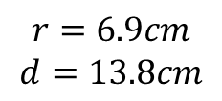
Task One- Write down the radius and diameter of each circle.
7m
10m
26mm
25cm
$$r=5m$$
$$d=10m$$
$$r=7m$$
$$d=14m$$
$$r=25cm$$
$$d=50cm$$
$$r=13mm$$
$$d=26mm$$
6.9cm
13.2mm
2.4m
0.8cm
$$r=1.2m$$
$$d=2.4m$$
$$r=0.8cm$$
$$d=1.6cm$$
$$r=6.6mm$$
$$d=13.2mm$$
$$r=6.9cm$$
$$d=13.8cm$$

Slide 14
24
7
30
Date
Circumference
EQ – Describe the relationship between the radius, diameter and circumference?
7

Slide 15
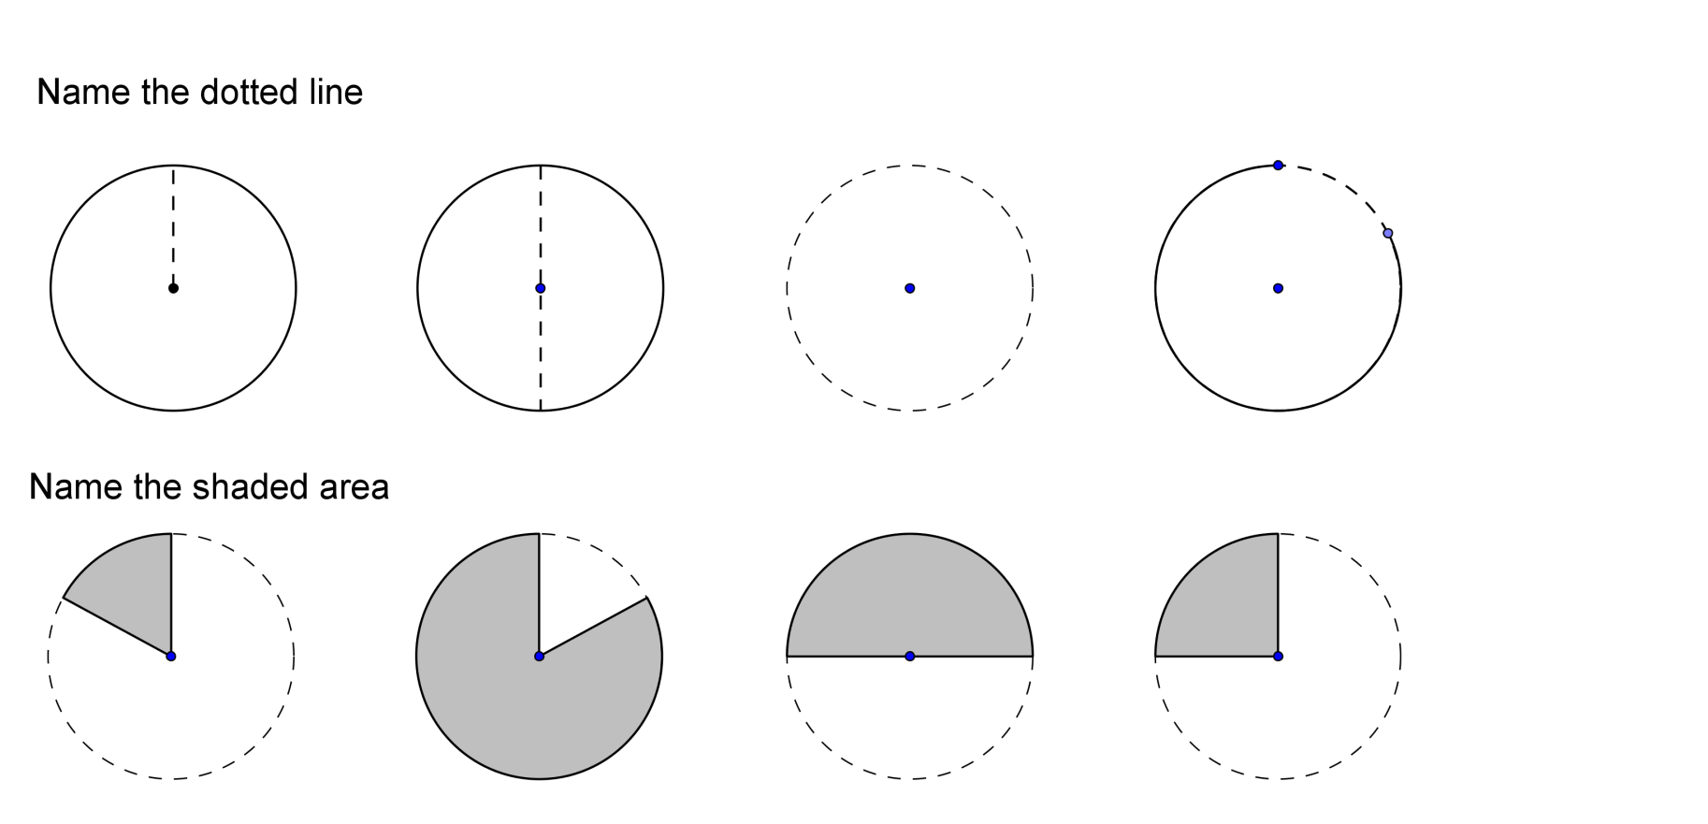
24
7
30
Date
Circumference
EQ – Describe the relationship between the radius, diameter and circumference?
Circumference is the perimeter of a circle
r
Radius
d
Diameter
7

Slide 16
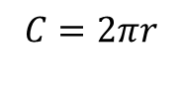
24
7
30
Date
Circumference
EQ – Describe the relationship between the radius, diameter and circumference?
Circumference is the perimeter of a circle
r
Radius
$$C=2πr$$
d
Diameter
7

Slide 17

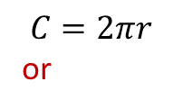
24
7
30
Date
Circumference
EQ – Describe the relationship between the radius, diameter and circumference?
Circumference is the perimeter of a circle
r
Radius
$$C=2πr$$
or
d
Diameter
$C=πd$
7

Slide 18
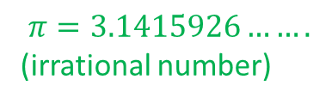
24
7
30
Date
Circumference
EQ – Describe the relationship between the radius, diameter and circumference?
Circumference is the perimeter of a circle
r
Radius
$$C=2πr$$
or
d
Diameter
$C=πd$
$$π=3.1415926…….$$
(irrational number)
7

Slide 19
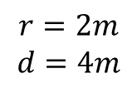
24
7
30
Date
Circumference
EQ – Describe the relationship between the radius, diameter and circumference?
Circumference is the perimeter of a circle
r
Radius
$$C=2πr$$
or
d
Diameter
$C=πd$
$$π=3.1415926…….$$
(irrational number)
Find the circumference of the circle(answers to 2.d.p)
$$r=2m$$
$$d=4m$$
2m
7

Slide 20
24
7
30
Date
Circumference
EQ – Describe the relationship between the radius, diameter and circumference?
Circumference is the perimeter of a circle
r
Radius
$$C=2πr$$
or
d
Diameter
$C=πd$
$$π=3.1415926…….$$
(irrational number)
Find the circumference of the circle(answers to 2.d.p)
$$r=2m$$
$$d=4m$$
2m
7

Slide 21
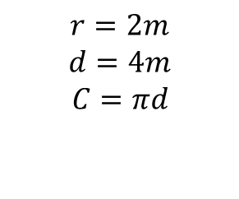
24
7
30
Date
Circumference
EQ – Describe the relationship between the radius, diameter and circumference?
Circumference is the perimeter of a circle
r
Radius
$$C=2πr$$
or
d
Diameter
$C=πd$
$$π=3.1415926…….$$
(irrational number)
Find the circumference of the circle(answers to 2.d.p)
$$r=2m$$
$$d=4m$$
$$C=πd$$
2m
7

Slide 22
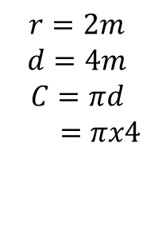
24
7
30
Date
Circumference
EQ – Describe the relationship between the radius, diameter and circumference?
Circumference is the perimeter of a circle
r
Radius
$$C=2πr$$
or
d
Diameter
$C=πd$
$$π=3.1415926…….$$
(irrational number)
Find the circumference of the circle(answers to 2.d.p)
$$r=2m$$
$$d=4m$$
$$C=πd$$
$=πx4$
2m
7

Slide 23
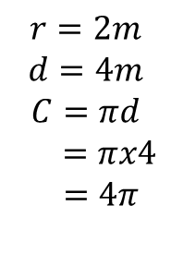
24
7
30
Date
Circumference
EQ – Describe the relationship between the radius, diameter and circumference?
Circumference is the perimeter of a circle
r
Radius
$$C=2πr$$
or
d
Diameter
$C=πd$
$$π=3.1415926…….$$
(irrational number)
Find the circumference of the circle(answers to 2.d.p)
$$r=2m$$
$$d=4m$$
$$C=πd$$
$=πx4$
$$=4π$$
2m
7

Slide 24
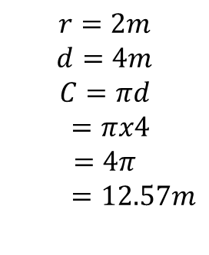
24
7
30
Date
Circumference
EQ – Describe the relationship between the radius, diameter and circumference?
Circumference is the perimeter of a circle
r
Radius
$$C=2πr$$
or
d
Diameter
$C=πd$
$$π=3.1415926…….$$
(irrational number)
Find the circumference of the circle(answers to 2.d.p)
$$r=2m$$
$$d=4m$$
$$C=πd$$
$=πx4$
$$=4π$$
$=12.57m$
2m
7

Slide 25
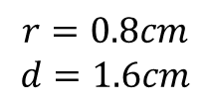
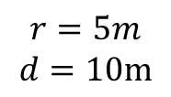
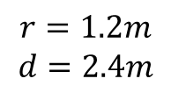
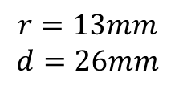
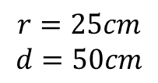
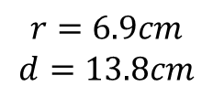
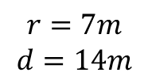
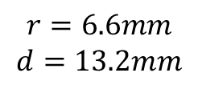
Task One- Find the circumference of the circles.(answers to 2.d.p)
7m
10m
26mm
25cm
$$r=5m$$
$$d=10m$$
$$r=7m$$
$$d=14m$$
$$r=25cm$$
$$d=50cm$$
$$r=13mm$$
$$d=26mm$$
6.9cm
2.4m
13.2mm
0.8cm
$$r=1.2m$$
$$d=2.4m$$
$$r=0.8cm$$
$$d=1.6cm$$
$$r=6.6mm$$
$$d=13.2mm$$
$$r=6.9cm$$
$$d=13.8cm$$

Slide 26
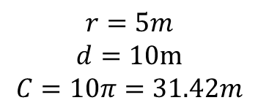
Task One- Find the circumference of the circles.(answers to 2.d.p)
7m
10m
26mm
25cm
$$r=5m$$
$$d=10m$$
$$C=10π=31.42m$$
$$r=7m$$
$$d=14m$$
$$r=25cm$$
$$d=50cm$$
$$r=13mm$$
$$d=26mm$$
6.9cm
2.4m
13.2mm
0.8cm
$$r=1.2m$$
$$d=2.4m$$
$$r=0.8cm$$
$$d=1.6cm$$
$$r=6.6mm$$
$$d=13.2mm$$
$$r=6.9cm$$
$$d=13.8cm$$

Slide 27
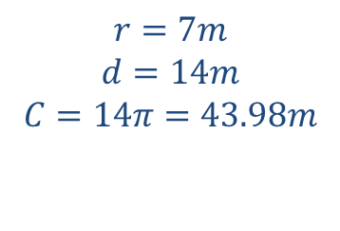
Task One- Find the circumference of the circles.(answers to 2.d.p)
7m
10m
26mm
25cm
$$r=5m$$
$$d=10m$$
$$C=10π=31.42m$$
$$r=7m$$
$$d=14m$$
$$C=14π=43.98m$$
$$r=25cm$$
$$d=50cm$$
$$r=13mm$$
$$d=26mm$$
6.9cm
2.4m
13.2mm
0.8cm
$$r=1.2m$$
$$d=2.4m$$
$$r=0.8cm$$
$$d=1.6cm$$
$$r=6.6mm$$
$$d=13.2mm$$
$$r=6.9cm$$
$$d=13.8cm$$

Slide 28
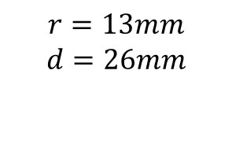
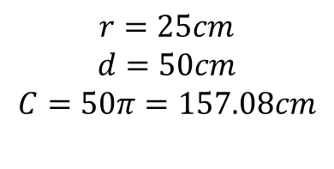
Task One- Find the circumference of the circles.(answers to 2.d.p)
7m
10m
26mm
25cm
$$r=5m$$
$$d=10m$$
$$C=10π=31.42m$$
$$r=7m$$
$$d=14m$$
$$C=14π=43.98m$$
$$r=25cm$$
$$d=50cm$$
$$C=50π=157.08cm$$
$$r=13mm$$
$$d=26mm$$
6.9cm
2.4m
13.2mm
0.8cm
$$r=1.2m$$
$$d=2.4m$$
$$r=0.8cm$$
$$d=1.6cm$$
$$r=6.6mm$$
$$d=13.2mm$$
$$r=6.9cm$$
$$d=13.8cm$$

Slide 29
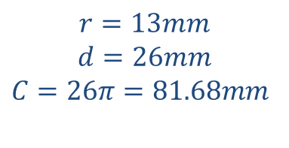
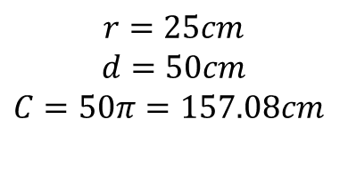
Task One- Find the circumference of the circles.(answers to 2.d.p)
7m
10m
26mm
25cm
$$r=5m$$
$$d=10m$$
$$C=10π=31.42m$$
$$r=7m$$
$$d=14m$$
$$C=14π=43.98m$$
$$r=25cm$$
$$d=50cm$$
$$C=50π=157.08cm$$
$$r=13mm$$
$$d=26mm$$
$$C=26π=81.68mm$$
6.9cm
2.4m
13.2mm
0.8cm
$$r=1.2m$$
$$d=2.4m$$
$$r=0.8cm$$
$$d=1.6cm$$
$$r=6.6mm$$
$$d=13.2mm$$
$$r=6.9cm$$
$$d=13.8cm$$

Slide 30
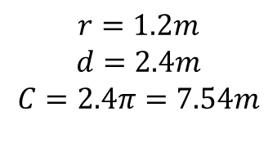
Task One- Find the circumference of the circles.(answers to 2.d.p)
7m
10m
26mm
25cm
$$r=5m$$
$$d=10m$$
$$C=10π=31.42m$$
$$r=7m$$
$$d=14m$$
$$C=14π=43.98m$$
$$r=25cm$$
$$d=50cm$$
$$C=50π=157.08cm$$
$$r=13mm$$
$$d=26mm$$
$$C=26π=81.68mm$$
6.9cm
2.4m
13.2mm
0.8cm
$$r=1.2m$$
$$d=2.4m$$
$$C=2.4π=7.54m$$
$$r=0.8cm$$
$$d=1.6cm$$
$$r=6.6mm$$
$$d=13.2mm$$
$$r=6.9cm$$
$$d=13.8cm$$

Slide 31
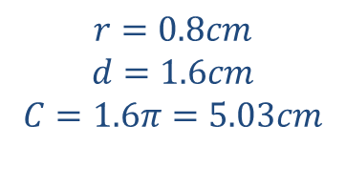
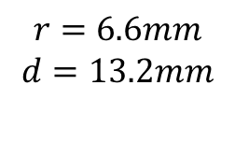
Task One- Find the circumference of the circles.(answers to 2.d.p)
7m
10m
26mm
25cm
$$r=5m$$
$$d=10m$$
$$C=10π=31.42m$$
$$r=7m$$
$$d=14m$$
$$C=14π=43.98m$$
$$r=25cm$$
$$d=50cm$$
$$C=50π=157.08cm$$
$$r=13mm$$
$$d=26mm$$
$$C=26π=81.68mm$$
6.9cm
2.4m
13.2mm
0.8cm
$$r=1.2m$$
$$d=2.4m$$
$$C=2.4π=7.54m$$
$$r=0.8cm$$
$$d=1.6cm$$
$$C=1.6π=5.03cm$$
$$r=6.6mm$$
$$d=13.2mm$$
$$r=6.9cm$$
$$d=13.8cm$$

Slide 32
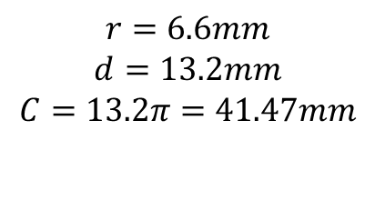
Task One- Find the circumference of the circles.(answers to 2.d.p)
7m
10m
26mm
25cm
$$r=5m$$
$$d=10m$$
$$C=10π=31.42m$$
$$r=7m$$
$$d=14m$$
$$C=14π=43.98m$$
$$r=25cm$$
$$d=50cm$$
$$C=50π=157.08cm$$
$$r=13mm$$
$$d=26mm$$
$$C=26π=81.68mm$$
6.9cm
2.4m
13.2mm
0.8cm
$$r=1.2m$$
$$d=2.4m$$
$$C=2.4π=7.54m$$
$$r=0.8cm$$
$$d=1.6cm$$
$$C=1.6π=5.03cm$$
$$r=6.6mm$$
$$d=13.2mm$$
$$C=13.2π=41.47mm$$
$$r=6.9cm$$
$$d=13.8cm$$

Slide 33
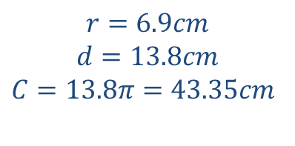
Task One- Find the circumference of the circles.(answers to 2.d.p)
7m
10m
26mm
25cm
$$r=5m$$
$$d=10m$$
$$C=10π=31.42m$$
$$r=7m$$
$$d=14m$$
$$C=14π=43.98m$$
$$r=25cm$$
$$d=50cm$$
$$C=50π=157.08cm$$
$$r=13mm$$
$$d=26mm$$
$$C=26π=81.68mm$$
6.9cm
2.4m
13.2mm
0.8cm
$$r=1.2m$$
$$d=2.4m$$
$$C=2.4π=7.54m$$
$$r=0.8cm$$
$$d=1.6cm$$
$$C=1.6π=5.03cm$$
$$r=6.6mm$$
$$d=13.2mm$$
$$C=13.2π=41.47mm$$
$$r=6.9cm$$
$$d=13.8cm$$
$$C=13.8π=43.35cm$$

Slide 34
Notes Review
24, 7 ,30
Date
Title
Essential question
Notes complete
Notes complete with colour and diagrams
Questions completed
Contents page filed in
Formula page filled in

Slide 35
Homework
Review your notes and write a summary answering the essential question.

